Slide 1
Snowpack modeling in the French mountains driven by short-range high-resolution weather forecasts
V. Vionnet¹, L. Queno¹, I. Dombrowski Etchevers², M. Lafaysse¹, Y. Seity², M. Dumont¹, E. Bazile², F. Karbou¹
CNRM, CEN, Météo France-CNRS, Grenoble, France
CNRM, Météo France-CNRS, Toulouse, France
SURFEX Users Workshop (27th Feb. 2017; Toulouse, France)

Slide 2
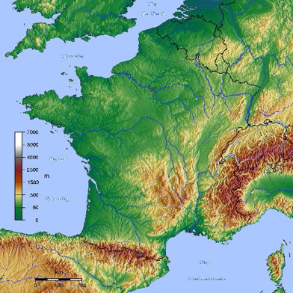
Presentation
  Operational snowpack modeling in the French mountains
  Experimental setup
  Seasonal snowfall
  Snowpack simulations
  Conclusions and perspectives
Toulouse
Pyrenees
French Alps

Slide 3
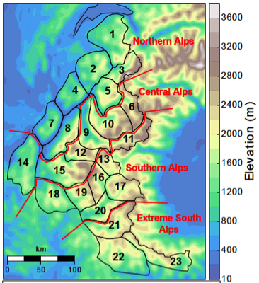

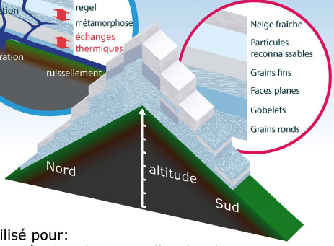
Snowpack modeling in the French mountains
1- Meteorological analysis and forecasting system SAFRAN
NWP system
ARPEGE (15 km)
Meteorological forcing at the massif scale per
300-m elevation bands
Observations
(AWS, manual station, …)
Durand et al. (1999)
Massif ( ~ 800 km²)
2- Detailed snowpack model SURFEX/Crocus
Air temperature
Rel. humidity
Windspeed
Incoming
solar radiation
Incoming
longwave
radiation
Rainfall
Snowfall
Vionnet et al. (2012)
Applications:
Avalanche hazard forecasting
Hydrological forecasting
Snowpack simulations per:
- elevations
- aspects
- slopes
North
South

Slide 4
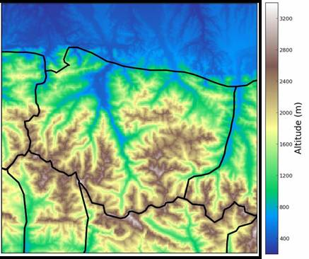
Towards a new modeling system
Limitations of the current system
Alternative forcing: the high-resolution NWP system AROME
Pic du Midi
Conceptual representation of the topography
Homogeneity of meteorological parameters within a massif
Captures the mean properties of snowpack but not the spatial variability
Vignemale
Haute-Bigorre range (French Pyrenees)
Operational since December 2008 over France (including the Alps and the Pyrenees)
Horizontal resolution 2.5 km (1.3 km since April 2015), 4 runs per day (00, 06, 12 and 18Z)
What is the ability of AROME to drive continuous seasonal snowpack simulations?

Slide 5
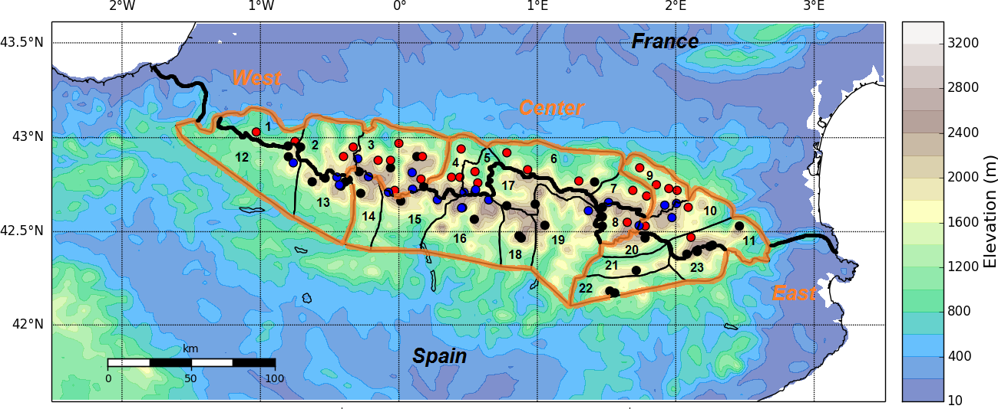
Context of the study
2 domains: French Alps and Pyrénées (resolution 2.5 km)
Snowpack model SURFEX/Crocus: operational version; 50 layers (branch V8_lafaysse)
4 years of simulations: August 2010 to July 2014
2 types of atmospheric forcing:
  Successive daily AROME forecasts (06-29h from 00Z)
  SAFRAN reanalysis interpolated over the 2.5-km grid
French Alps
Pyrénées

Slide 6
Seasonal snowfall (1)
Overall: larger snowfall amount with AROME compared to SAFRAN
But: strong spatial structure of differences

Slide 7
Seasonal snowfall (2)
Regions of significant differences:
Windward and leeward sides of mountains ranges (e.g. Vercors)
High-altitude regions ( approx. above 1700 m)

Slide 8
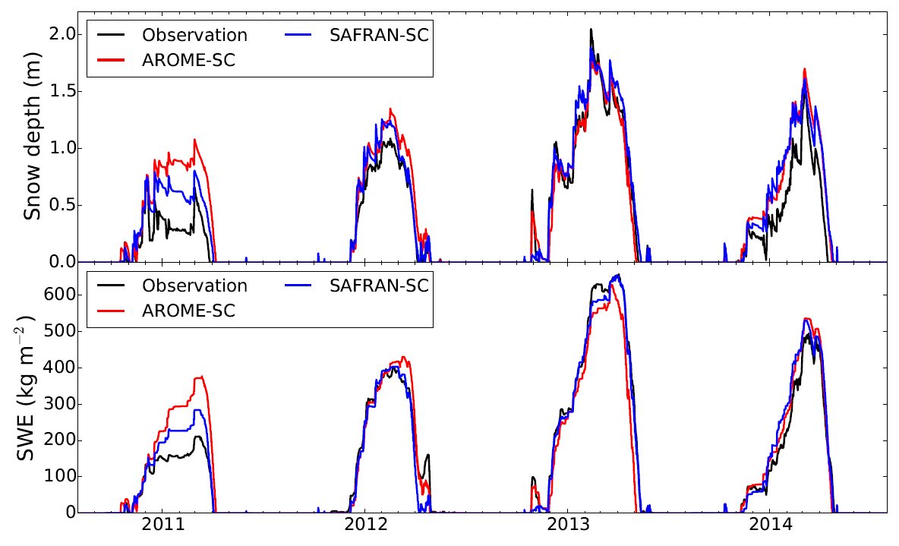
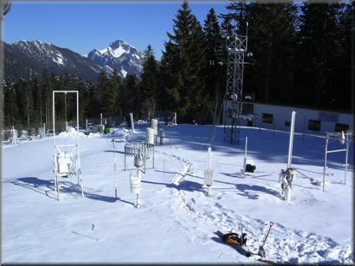
Snowpack evolution at Col de Porte (1325 m)
Good agreement between simulations and observations
Winter 2010/11: 2 errors of precipitation phase for AROME
Snow depth bias: 15 cm (AROME); 13 cm (SAFRAN)

Slide 9
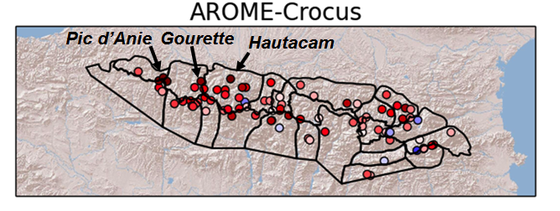

Snowpack scores
Global scores (Alps: 79 stations; Pyrénées: 83 stations)
Spatial variability of bias for AROME-Crocus (Pyrénées)
Score | Bias (cm) |  | Std Dev. of Errors (cm)
Forcing | AROME | SAFRAN | AROME | SAFRAN
Alps | 40 | 18 | 50 | 37
Pyrénées | 55 | 22 | 70 | 57
Overestimation of snow depth by AROME-Crocus
Positive bias decreasing from West to East
Max. positive bias for stations exposed to NW-W flows from the Atlantic ocean

Slide 10
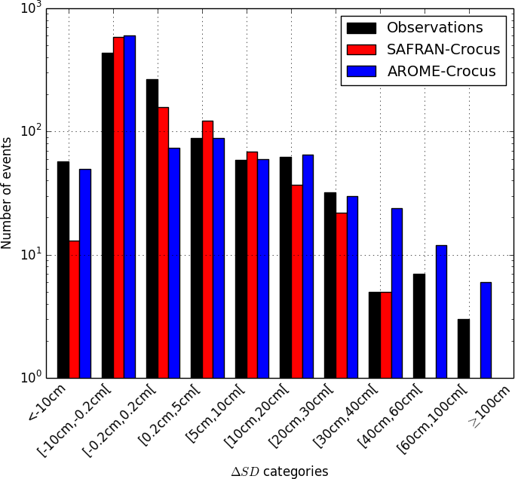
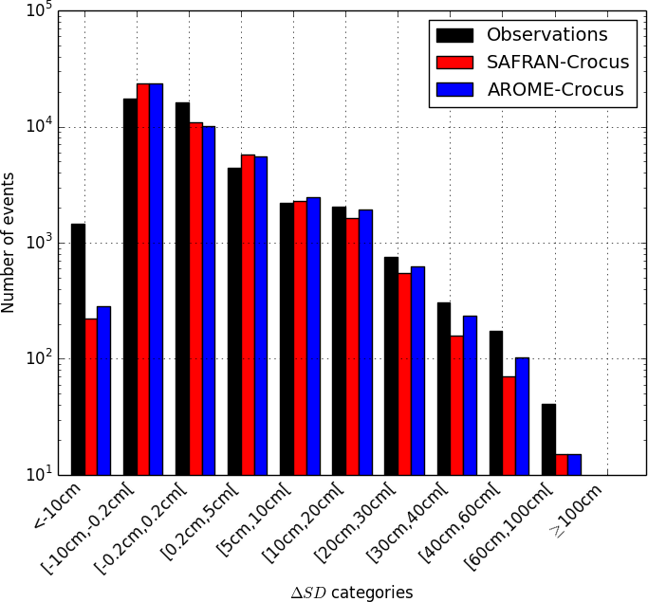
Daily snow depth changes
A
ΔHTN = HTN_{J} – HTN_{J-1}
Categorical study over the Pyrenees
Ablation/Settling
Accumulation
Atlantic foothills
Accumulation
Underestimation of strong snow accumulation
Except for the Atlantic foothills
Ablation
Underestimation of strong snow depth decrease :
  wind-induced erosion (not simulated by the model)
  strong melting
Main explanation for the positive bias

Slide 11

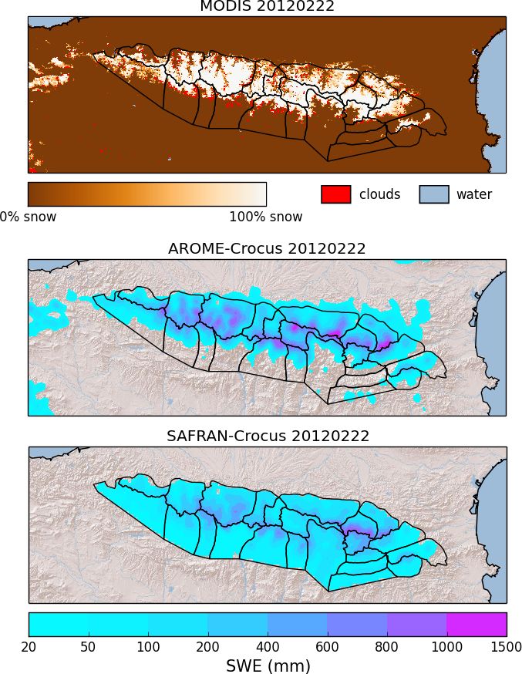
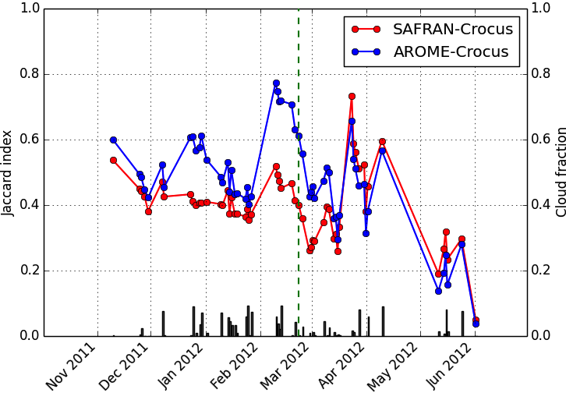
Snowpack spatial variability
Winter 2011/12: strong contrast of snow cover between France and Spain
Strong influence of NW-W flows
Seasonal evolution
Similarity index: Jaccard index
Better representation of the spatial snow cover distribution by AROME-Crocus

Slide 12
Conclusions and perspectives
  AROME forcing brings valuable information for snowpack modeling:
    Snowpack spatial variability
    Daily snow accumulation
  But: overestimation of snow depth: AROME-Crocus, purely based on AROME forecast, fails at improving snow depth scores compared to SAFRAN-Crocus including a precipitation analysis at the massif scale.
  On-going work:
    Latest version of AROME: horizontal resolution 1.3 km
    Distributed meteorological analysis system :
      MESCAN for precipitation (guess from AROME) (coll. GMAP, GMME)
      Satellite products for incoming LW and SW
  Perspective: data assimilation directly into the snowpack model (e.g. MODIS reflectance)
More details: - Quéno et al. (TC, 2016)
- Vionnet et al. (JHM, 2016)

Slide 13
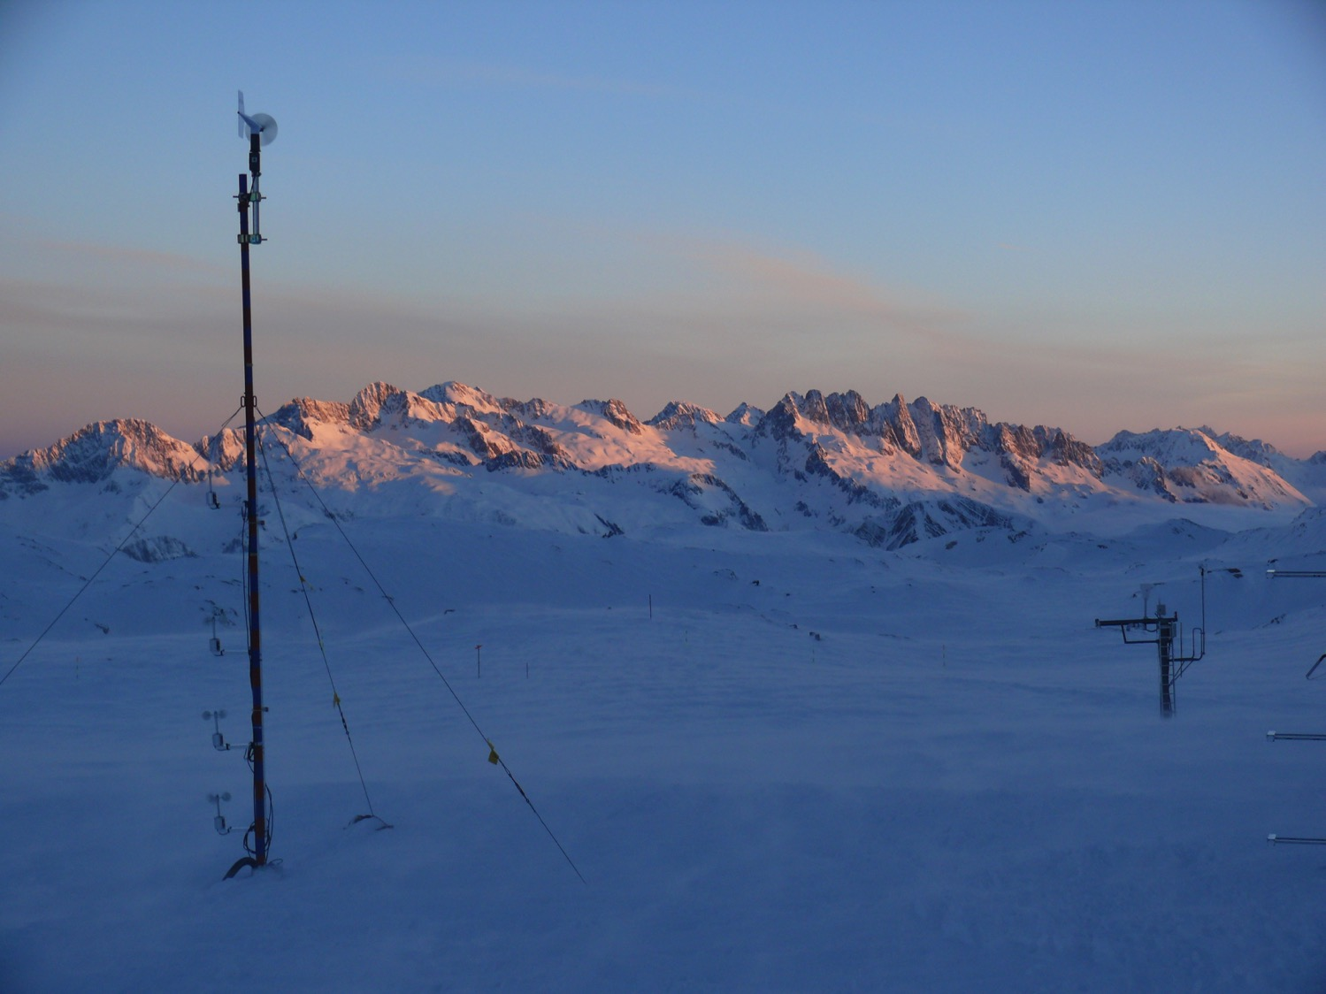
Thank you for your attention!
thanks.JPG

