Slide 1

Using SURFEX to investigate urban climate in hungarian cities
Gabriella Zsebeházi¹
Gabriella Szépszó¹ (PhD supervisor) and Rafiq Hamdi² (consultant)
¹Regional Climate Modelling Group, Hungarian Meteorological Service
Budapest (Hungary)
²Royal Meteorological Institute
Brussels (Belgium)
1st SURFEX User Workshop
Toulouse, 27 February – 1 March 2017

Slide 2
Outline
Motivation
Models and methods
Validation
Sensitivity test
Conclusions and future plans

Slide 3
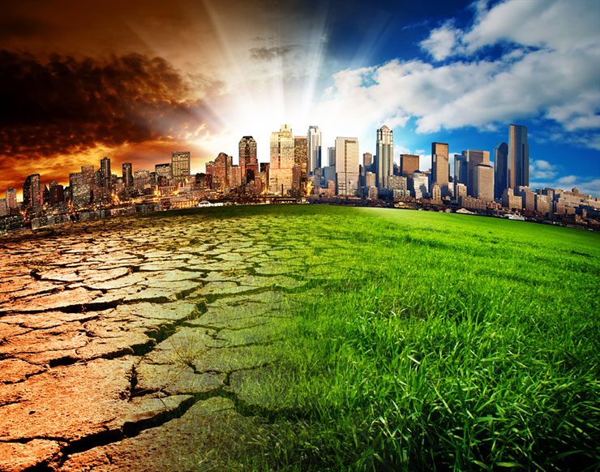
Motivation
High demand to estimate exposure of cities to climate change
Regional climate models (RCMs)
detailed information
about background climate
10-25 km horizontal
resolution → cities: bare
rocks / substituted by
neighbouring land cover
quantitatively
proper adaptation strategies
http://climate.nasa.gov/solutions/adaptation-mitigation/

Slide 4
Why SURFEX?
Transient regional climate simulations are performed with ALADIN-Climate at HMS
Land surface processes are computed by SURFEX in ALADIN
Forcing for SURFEX can be obtained directly
Goals:
To perform long term urban impact studies for the past (validation on climate time scale) and for the future
It can be fulfilled only with a medium-complexity model (neighbourhood scale)

Slide 5
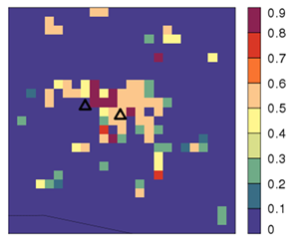
Methodology for validation
observational stations
  Source: re-analysis driven ALADIN-Climate
  No TEB in ALADIN
  Special configuration of ALADIN (fullpos) is applied for interpolation 10 km → 1km
  Simulation period: 1991–2000
Fraction of town

Slide 6
SURFEX set-up
Version | 5.1
Resolution | 1 km
Forcing heigth | 30 m
Forcing update frequency | 3 hour
Surface scheme | TEB and ISBA-3L
SBL scheme | yes
Land cover | ECOCLIMAP-I
Continuous simulations are performed

Slide 7
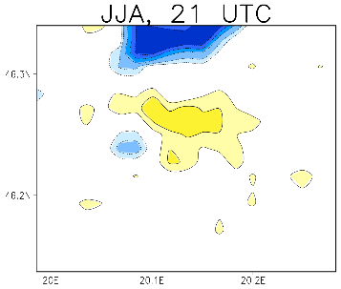
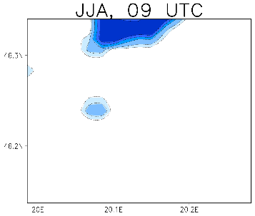
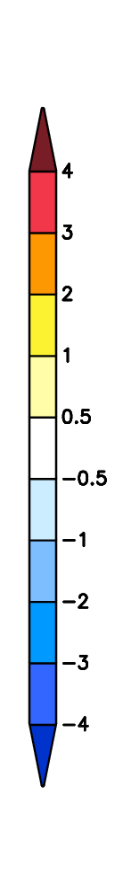
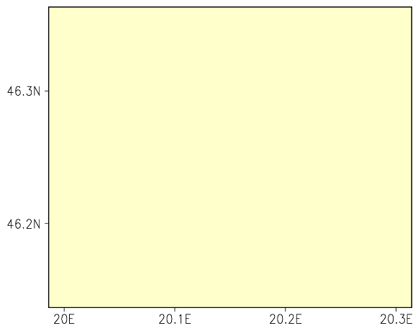

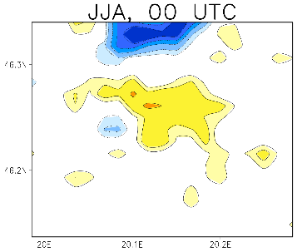
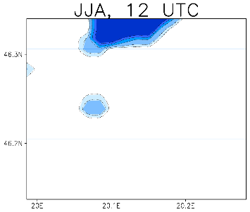
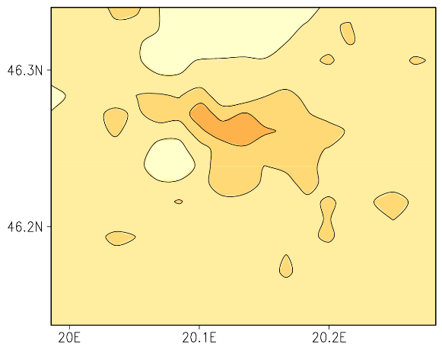
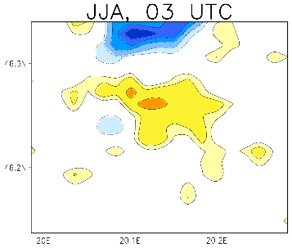

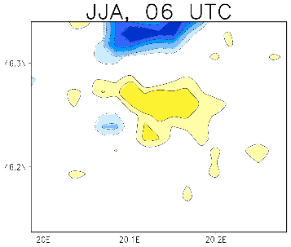

Results
Summer UHI
1991–2000
2-m temperature
1991–2000, JJA, 00UTC
ALADIN, 10km
SURFEX, 1km
i : gridpoints

Slide 8
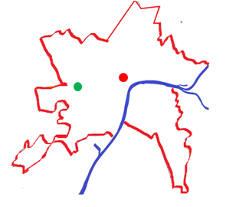
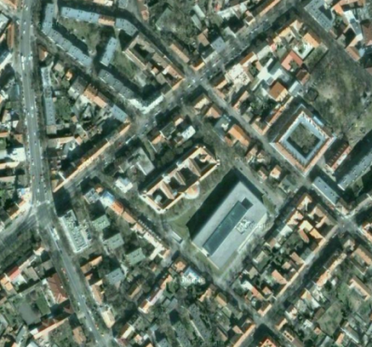
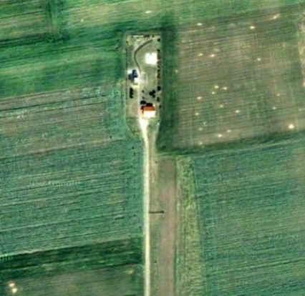
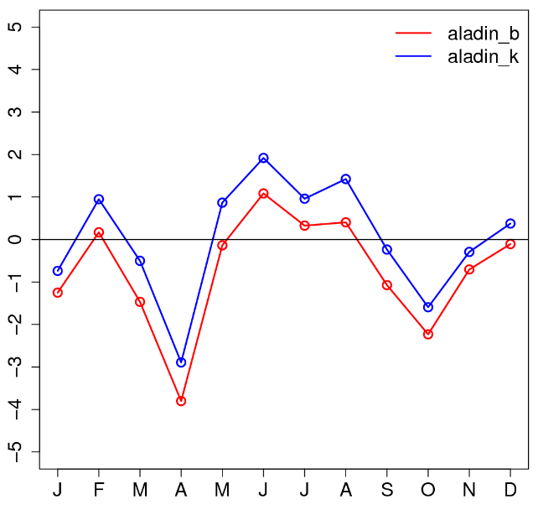
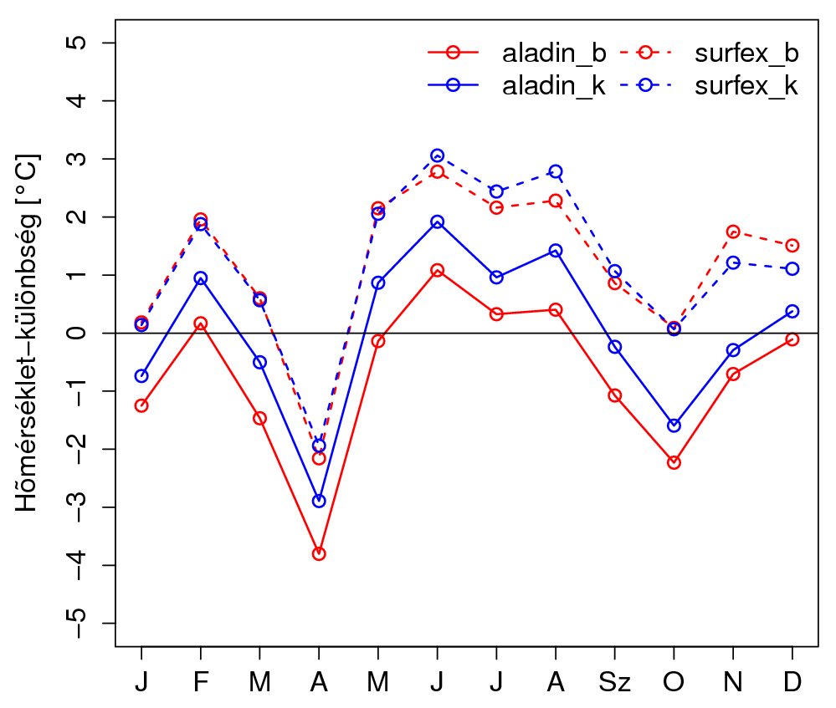
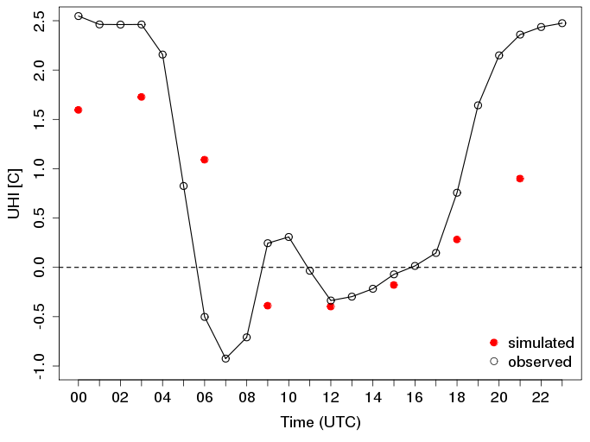
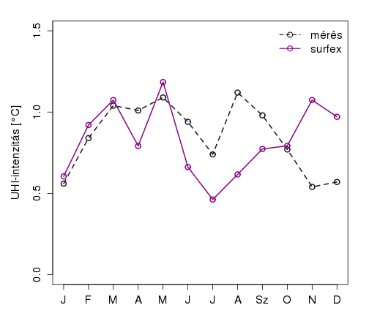
Validation, 1999-2000
Annual cycle
alad_in
alad_out
alad_in
alad_out
surfex_in
surfex_out
Temperature-difference [°C]
Daily cycle
summer UHI, 1999–2000
Temperature bias
Slight shift in diurnal cycle
Underestimation at night
observation
surfex
UHI [°C]
UHI-intensity [°C]
SURFEX may correct ALADIN biases → relatively good UHI
UHI

Slide 9
Sensitivity test
Goals:
Understand model behaviour
Find the most sensitive settings → possibly improve SURFEX
Focus on:
Coupling strategy of atmospheric forcings
SURFEX settings
Land surface information
Frequency of forcing update
Height of forcing

Slide 10
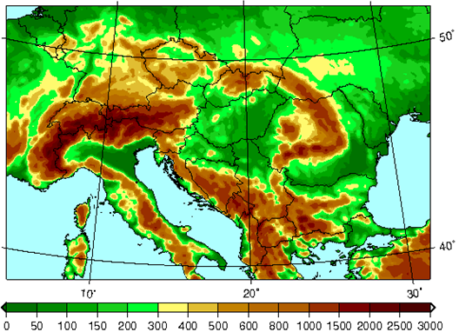
Model set-up
ALADIN domain
Atmospheric forcings: ALADIN-Climate
Version | 5.2
LBC | ERA-Interim
Domain | Central-Europe
Resolution | 10 km
Period | 1 year (2001)
SURFEX domain
SURFEX
Version | 7.3 (upgrade)
Domain | Szeged
Resolution | 1 km
Frequency of forcing update | 1 h / 3 h | EXP_[.]h
Height of forcings | 20, 30, 40, 50 m | EXP_[.]m
name

Slide 11
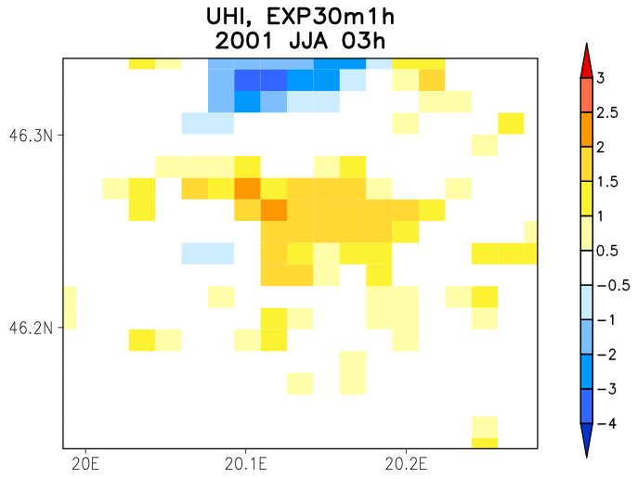
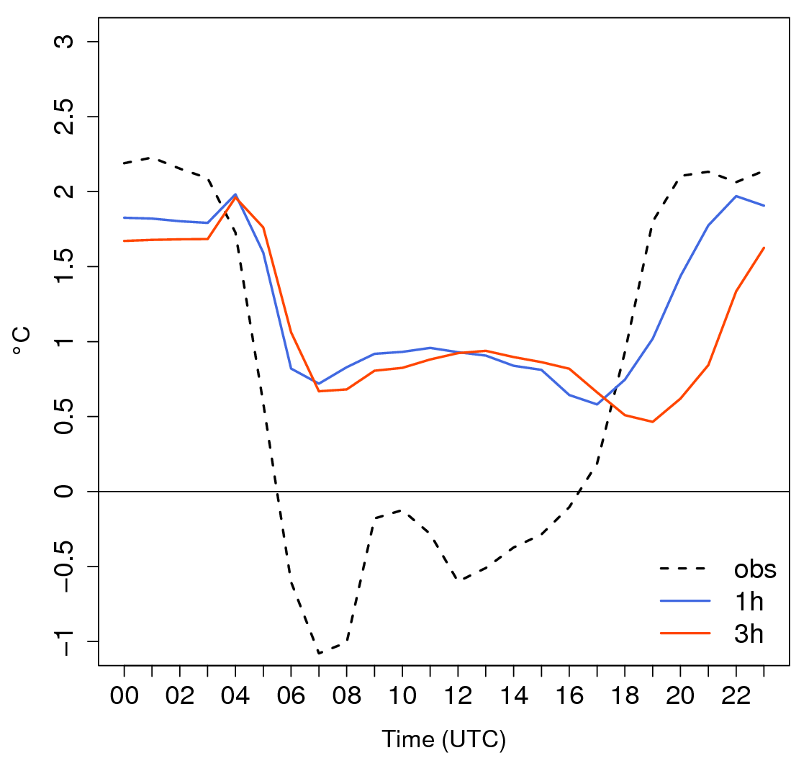
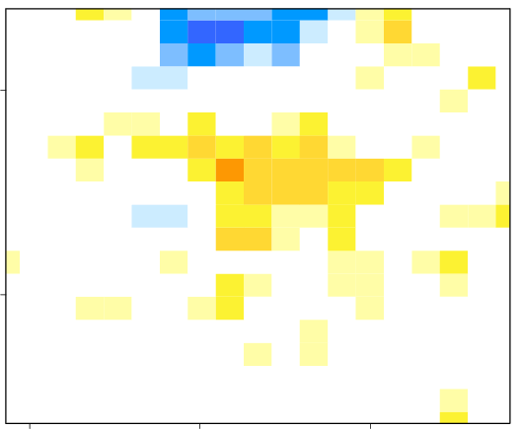
Results – forcing update
UHI
JJA, 03UTC
Summer daily cycle of UHI in the reference points
Daily cycle is poorly simulated
Day
urban gridpoint is too warm
1h
Night
Larger UHI in EXP_1h
Evolution of nocturnal UHI delayed
3h
EXP_1h: larger UHI extended

Slide 12
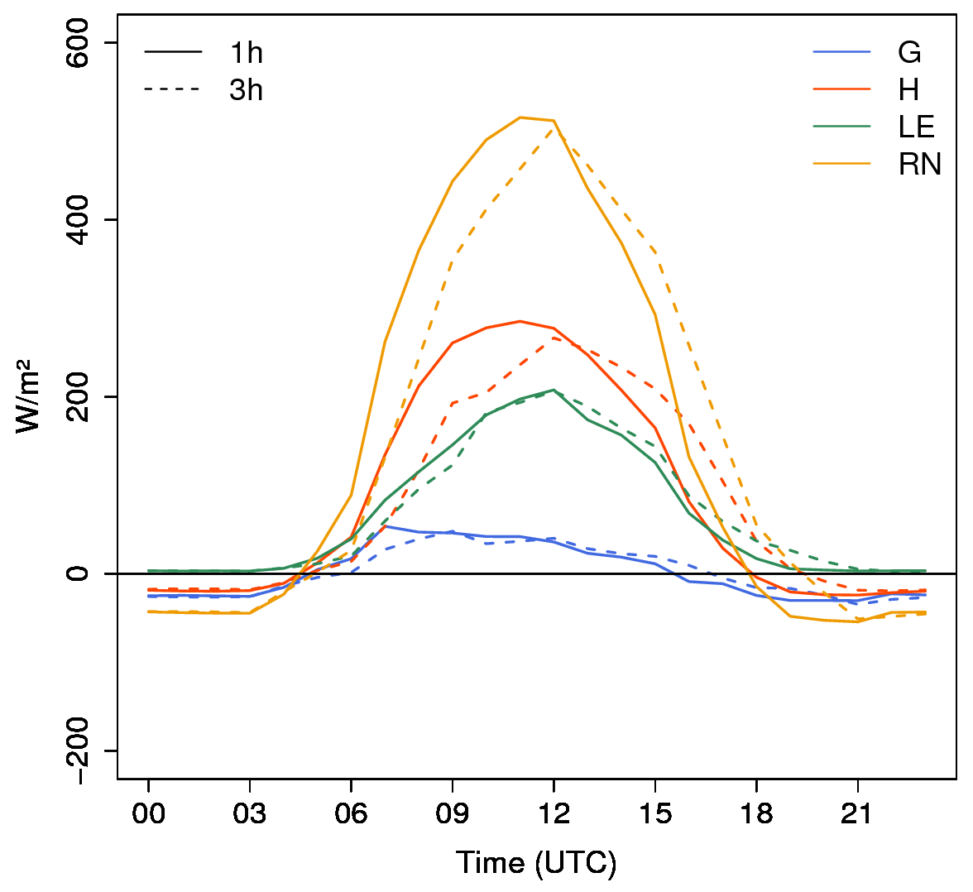
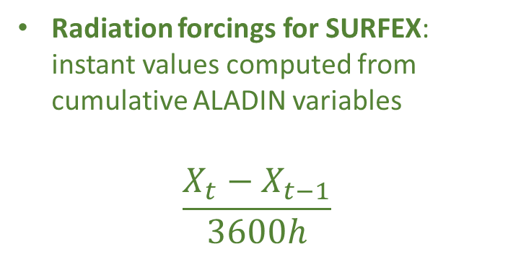
Reason of the time shift
Radiation forcings for SURFEX: instant values computed from cumulative ALADIN variables
$$\frac{X_{t}−X_{t−1}}{3600h}$$
Surface energy balance components in the urban gridpoint in summer
EXP_3h: shift in RN → influence on all turbulent fluxes
Saving ALADIN results 3 hourly is too sparse

Slide 13
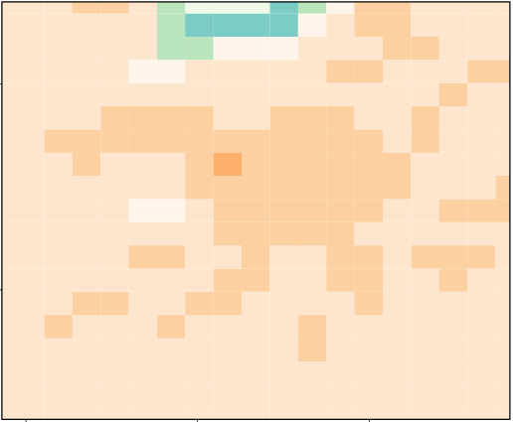
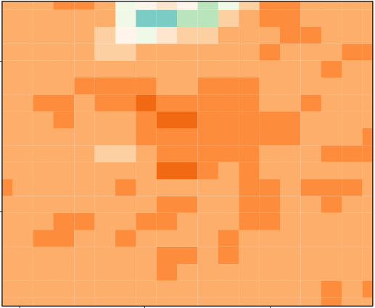
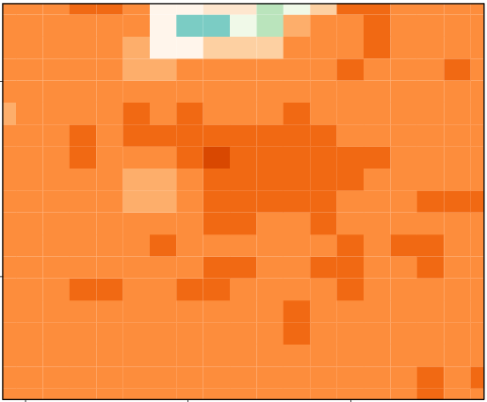
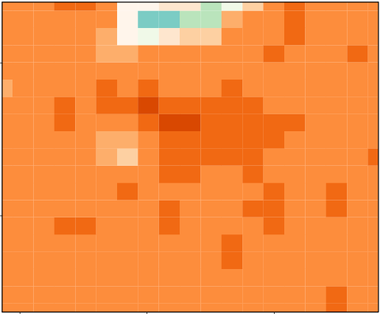
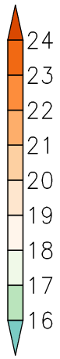
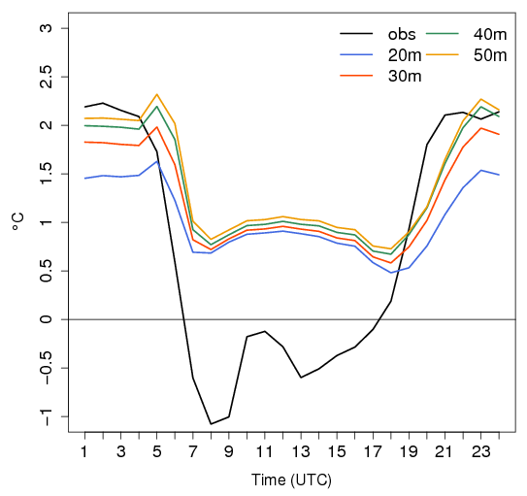
Results – height of forcings
2-m temperature, summer
20 m
30 m
40 m
50 m
UHI [JJA]
Higher forcing level → warmer 2-m temperature
larger UHI. But only a positive shift, no physical improvement
Stronger effect at night [stable conditions]

Slide 14
Conclusions & discussion
Conclusions
Long term validation
magnitude of the nocturnal UHI is underestimated
First part of our sensitivity test:
3-hour forcing time step cannot describe sufficiently the fast diurnal changes → difficulty: large storage capacity for RCM outputs
Forcing from higher levels → larger 2-m temperature and UHI, but no amelioration in daily variability
Discussion
Big difference between UHI diurnal cycle in 7.3 and 5.1 version
Warmer daily temperatures in the city → + UHI
?

Slide 15
Thank you very much for your attention!
Future plans
To continue the sensitivity test
TEB in ALADIN-Climate → does it have an added value on 10 km resolution?
Computation method of 2-m temperature (CANYON vs. CANOPY)
Land surface information (ECOCLIMAP vs. observation)
e-mail: zsebehazi.g@met.hu

