Slide 1
Developments of the hydrological component of the urban hydro-microclimate model TEB-Hydro
SURFEX workshop
27th February – 1st March 2017
STAVROPULOS-LAFFAILLE Xenia PhD Student at IFSTTAR, GERS, LEE, route de Bouaye CS4, 44344 Bouguenais, France Supervisors: Hervé ANDRIEU & Katia CHANCIBAULT

Slide 2
Context
Model TEB-Hydro
Methodology
Results and discussion
Conclusion and perspectives

Slide 3
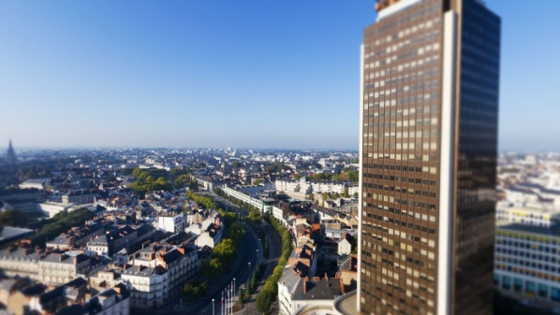
Introduction
Context
Population growth in cities
Expansion and densification of urban surfaces
Augmentation of anthropic emissions
→ Influence on the hydrological cycle:
Sensible heat fluxes
Sensible heat fluxes
Latent heat fluxes
Latent heat fluxes
Evapotranspiration
Evapotranspiration
Runoff
Runoff
Source: http://www.localwom.com
Infiltration
Source: http://www.exponantes.com
Infiltration
0%
Urbanisation
75% - 100%
Source: WMO (2008)
Notes:
Influence sur le cycle de l’eau
Inondations
Impact sur le régime d’eau dans le sol
Pollution du milieu naturel
Influence sur le microclimat urbain
Ilots de chaleur
Plus de précipitation, orage, couverture nuageuse
Piégeage des polluants atmosphérique
Changement climatique
Evénements extrêmes météorologiques
Aggravation des phénomènes liés à l’urbanisation
Stratégie d’adaptation
Réduction de l'évapotranspiration ou flux de chaleur latentes
Réduction des échanges entre la surface et le sous-sol
Drainage de l’eau du sol par les réseaux
Réduction de la capacité de rétention de l'eau en surface → Augmentation quantitative du ruissellement surfacique
Temps de réponse des bassin urbains plus court

Slide 4
Context
Climate and demographic changes
Urban development strategies
Alternative storm water management
hydrologic/microclimate modelling
Increase of impact studies on urban hydrology
Alternative thermic management
Hydrologic
and energetic processes?
Role of vegetation
In cities
Continuous regime or extreme events?
Urban
scales?
Notes:
Couplage entre le bilan en eau et en énergie n’est pas satisfaisant

Slide 5
Context
Objectif
Development of a hydro-microclimate model adapted to urban scales in order to evaluate adaptation strategies to global change.
TEB-Hydro
Hydrologic component
Energetic component
Better understanding of urban hydrological processes and their reproduction within the model.
Sensitivity analyses / Calibration
Validation

Slide 6
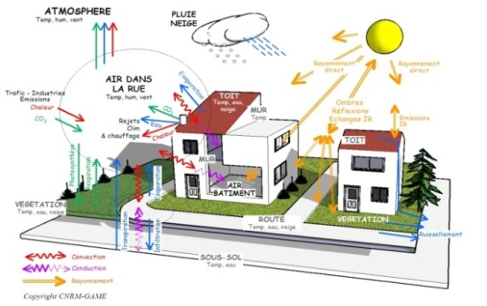
Hydro-microclimate model: TEB-Hydro
Model
Resolution of the water and energy balance by TEB (Masson, 2000) coupled with ISBA-DF (Boone et al., 1999)
Street canyon approach (Oke, 1987)
Integration of natural surfaces (Lemonsu et al., 2012; De Munck et al., 2014) and water fluxes in the urban subsoil (Chancibault et al., 2014)
3 compartments “building”, “road” and “garden”
Energy balance
Water balance
Source: http://www.cnrm-game-meteo.fr
Source: Lemonsu et al. (2012)

Slide 7
Hydrological processes: TEB-Hydro
Model
ETP
INFILTRATION
RUNOFF
SEWER DRAINAGE
VERTICAL & HORIZONTAL TRANSFER
VERTICAL & HORIZONTAL TRANSFER
RUNOFF
DEEP DRAINAGE
DEEP DRAINAGE
Building
Road
Garden
Notes:
Partie « jardin »: Les processus hydrologiques et thermiques sont traités dans TEB couplé avec le modèle ISBA-DF (Boone, 2000)
Infiltration de l'eau via la structure routière
L’eau ruisselée des surfaces imperméables, mais non-connectées aux réseaux d’assainissement, rejoint la partie « jardin »
Les réseaux d'assainissement sont pris en compte uniquement à travers le drainage de l’eau du sol par les réseaux
Discrétisation verticale du sol et transferts hydriques verticaux dans chaque compartiment
Homogénéisation des contenus en eau du sol intra-maille

Slide 8
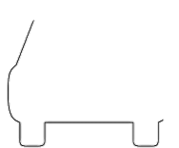
Improvements of hydrological processes in urban sub-soil (Chancibault et al., 2014 ; Allard, 2015 ; Chancibault et al., 2015)
Model
Horizontal water exchanges between the 3 compartments within a single grid cell
Drainage processes by the sewer system
When soil water content reaches field capacity
Drainage depends on hydraulic conductivity, the sewer watertightness, the sewer density and the ratio of water content to water content at saturation
Limitation of deep drainage
${INF}_{sew,i }= k_{sew,i}∗I_{p,sew}∗ D_{sew,i}∗ \frac{W_{i}}{W_{sat,i}}$
if ${WG}_{i, sewer}≥{WG}_{fc}$
WG_{GARDEN}
WG_{AVERAGE}
WG_{BUILDING}
WG_{ROAD}

Slide 9
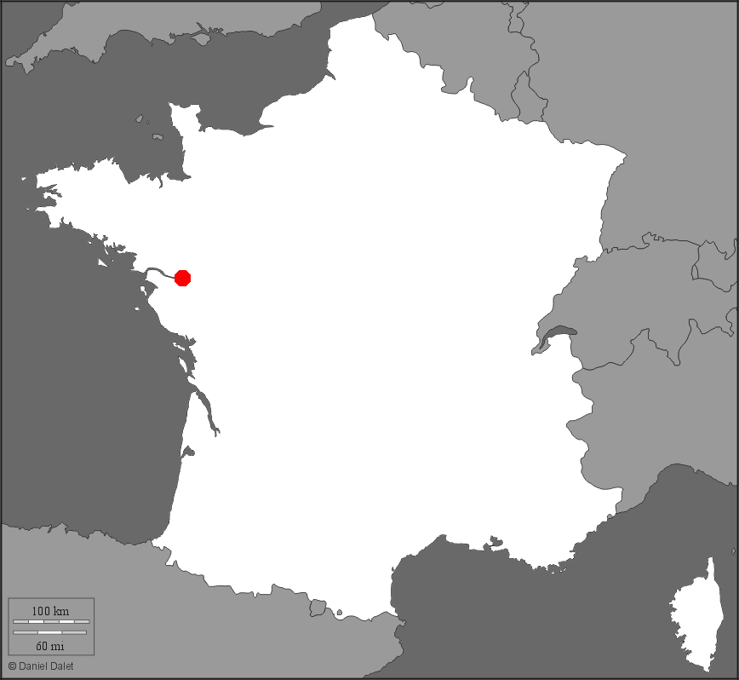
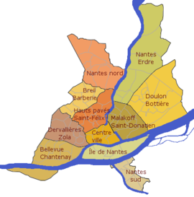
Experimental sites in Nantes
Paris
Methodo.
Nantes
Toulouse
Pin Sec
Catchment | Rezé | Pin Sec
Climate | Oceanic (~800mm/a)
Area | 4,7 ha | 31 ha
Type | Residential H_{avg}=5,9m (single housing) | Residential H_{avg}=9,3m (single & shared housing)
Occupation | 55% gardens , 17% buildings, 28% roads | 49% gardens, 19% buildings, 32% roads
Imp. surfaces connected to sewer | 85% | 65%
Impermeability | 45% | 51%
Source: Le Delliou et al. (2009)
Rezé
Etudes antérieures:
Rezé: Dupont (2001), Rodriguez et al. (2003), Berthier et al. (2004), Lemonsu et al. (2007), Rodriguez et al. (2008)
Pin Sec: Le Delliou et al. (2009), Musy et al. (2009), Ruban et al. (2010), Furusho (2012), Jankofsky (2012), Percot (2012), Rodriguez et al. (2014)
Source: Dupont (2001)

Slide 10
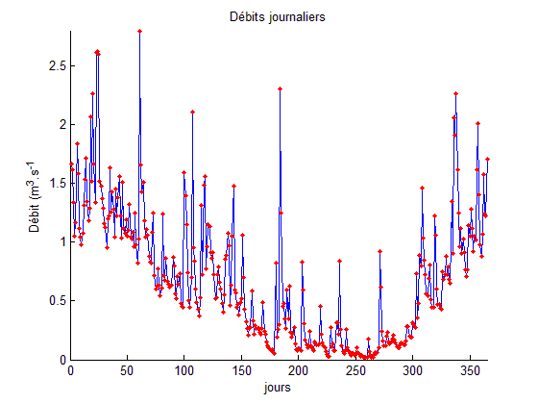
Application of the model
Methodo.
Model settings
SURFEX v7.3
Application on a single grid cell (1D)
Set of data over several years (in-situ and continuous instrumentation)
Rezé: 1993-1998
Pin Sec: 2010-2012
Off-line mode
forcing by meteorological data (station of Météo-France)
Δt forcing = 60 min
Δt numeric = 5 min

Slide 11
Parameters of the model:
Methodo.
Sensitivity analyses
Calibration
SROOF
Z0TOWN
SROOF
CONN
SROAD
Outcome variable | Simulation | Criterion KGE
 |  | MIN | MAX
RUNOFF_Town | SROOF | 0,92 | 0,94
 | SROAD | 0,99 | 0,94
 | IROAD | 0,94 | 0,39
 | CONN | 0,84 | 0,93
 | Z0TOWN | 0,97 | 0,98
RUNOFF_Sewer | IP | -0,28 | -2,40
WG | SOILCLAY | 0,72 | 0,84
 | SOILSAND | 0,59 | 0,60
IROAD
SOILCLAY
SOILSAND
IP

Slide 12
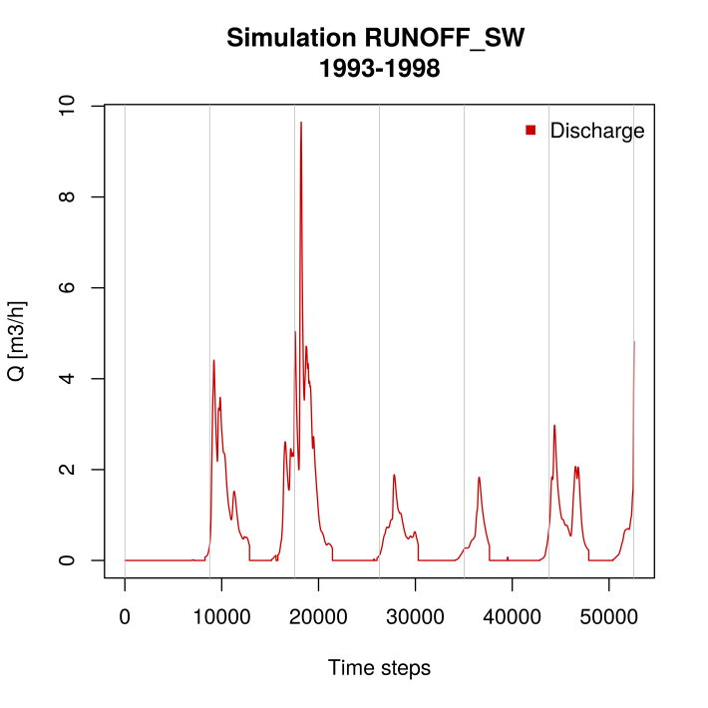
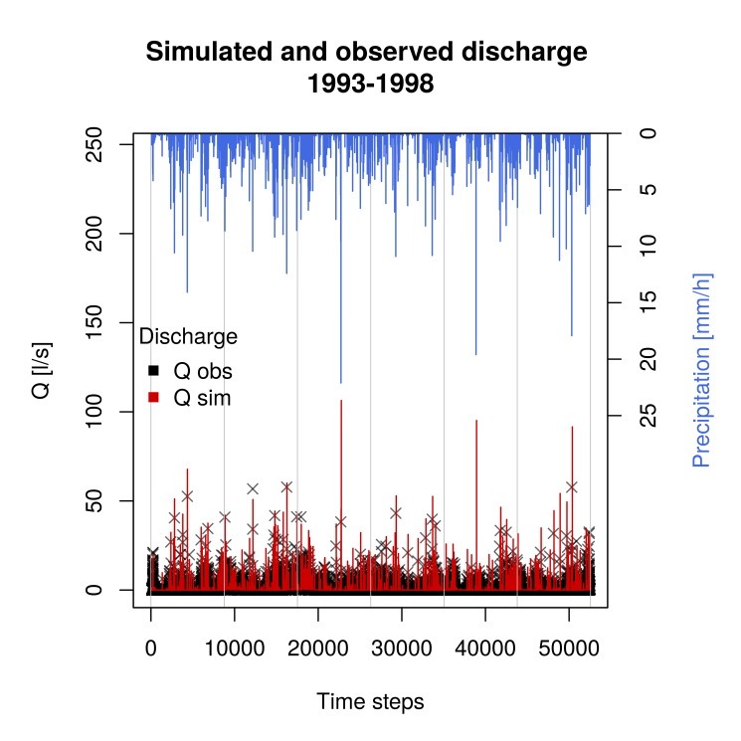
Rezé catchment
Results
Sewer discharge due to soil water infiltration
Q_{sim} = 9.8 m³/h
Calibration
IROAD → 10⁻⁵ (m/s)
IP →0.04 (-)
Characteristics of the Rezé catchment:
Silty clay
Vegetation:100% low vegetation (LV)
Simulation period 1993-1998
Validation on sewer discharge
Max. observed discharge in the sanitary sewer due to soil water infiltration in winter 1994/95 (Berthier 1999) :
Q_{obs} =0.008 m³/h/m → 10.3 m³/h

Slide 13
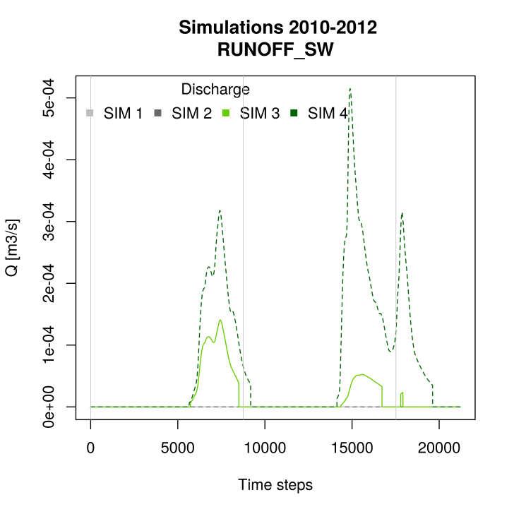
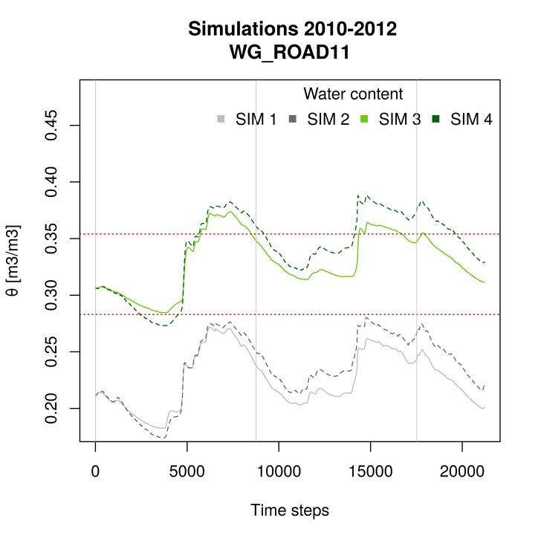
Pin Sec catchment
Results
Sewer discharge due to soil water infiltration
Same model settings as for Rezé
Characteristics of the Pin Sec catchment
Silty sand
Vegetation: 38% low vegetation (LV), 25% high vegetation (HV),37% bare soil (BS)
Simulation period 2010-2012
Water content in the sewer soil layer
Simulation | Soil texture | Natural surfaces | ETP [%]
Sim 1 | silty sand | LV+HV+BS | 86
Sim 2 | silty sand | LV | 74
Sim 3 | silty clay | LV+HV+BS | 88
Sim 4 | silty clay | LV | 75
WG_{fc}
WG_{fc}

Slide 14
Conclusion and Perspectives
Conclusion
& Persp.
Sensitivity analyses → identified parameters for calibration:
IROAD, CONN, IP, SOILCLAY, SOILSAND
Hydrologic validation on two small urban catchments:
Rezé: Validation on sewer discharge
Application on another catchment opens new questions:
Soil texture and hydraulic conductivity at saturation: sandy soils represent a high drainage capacity
Representation of urban vegetation: Evapotranspiration is too important for an urban catchment
SURFEX v8
New developments of representation of trees (E. Redon)

Slide 15
Thank you for your attention !
SURFEX workshop
27th February – 1st March 2017
Any questions?
Image: http://fr.123rf.com

Slide 16
Représentation des Résultats
Résultats
→ Critère statistique de Kling-Gupta (KGE) (Gupta et al. 2009)
$$KGE=1−\sqrt{{\left(r−1\right)}^{2}+{\left(α−1\right)}^{2}+{\left(β−1\right)}^{2}}$$
Avec :
le coefficient de corrélation linéaire (r) entre les variables simulées et de référence:
$$r=\frac{\sum{((Dsim\left(t\right)−\overline{Dsim}})∗(Dref\left(t\right)−\overline{Dref}))}{\sqrt{\sum{{(Dsim\left(t\right)−\overline{Dsim)}}^{2}}}∗\sqrt{\sum{{(Dref\left(t\right)−\overline{Dref)}}^{2}}}}$$
la variabilité relative (α) représentée par le quotient des écarts-types sur les variables simulées et de référence:
$$α=\frac{\sqrt{\sum{{(Dsim\left(t\right)−\overline{Dsim)}}^{2}}}}{\sqrt{\sum{{(Dref\left(t\right)−\overline{Dref)}}^{2}}}}$$
le biais (β):
$$β=\frac{\overline{Dsim}}{\overline{Dref}}$$

