Slide 1
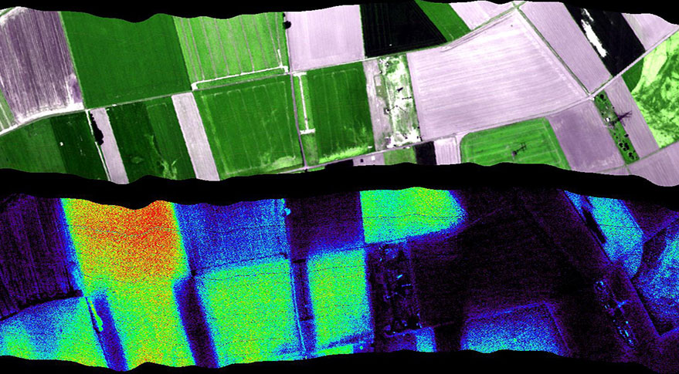
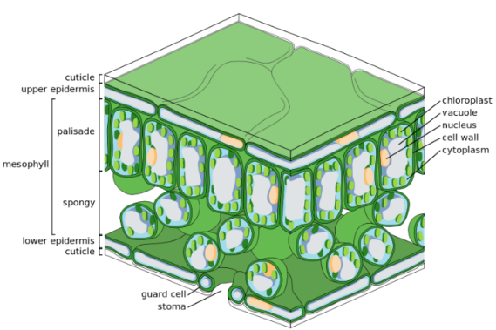
Comparing SURFEX photosynthesis simulations to fluorescence observations at European scale
Delphine Leroux, J.-C. Calvet, S. Munier, C. Albergel
CNRM, Toulouse

Slide 2
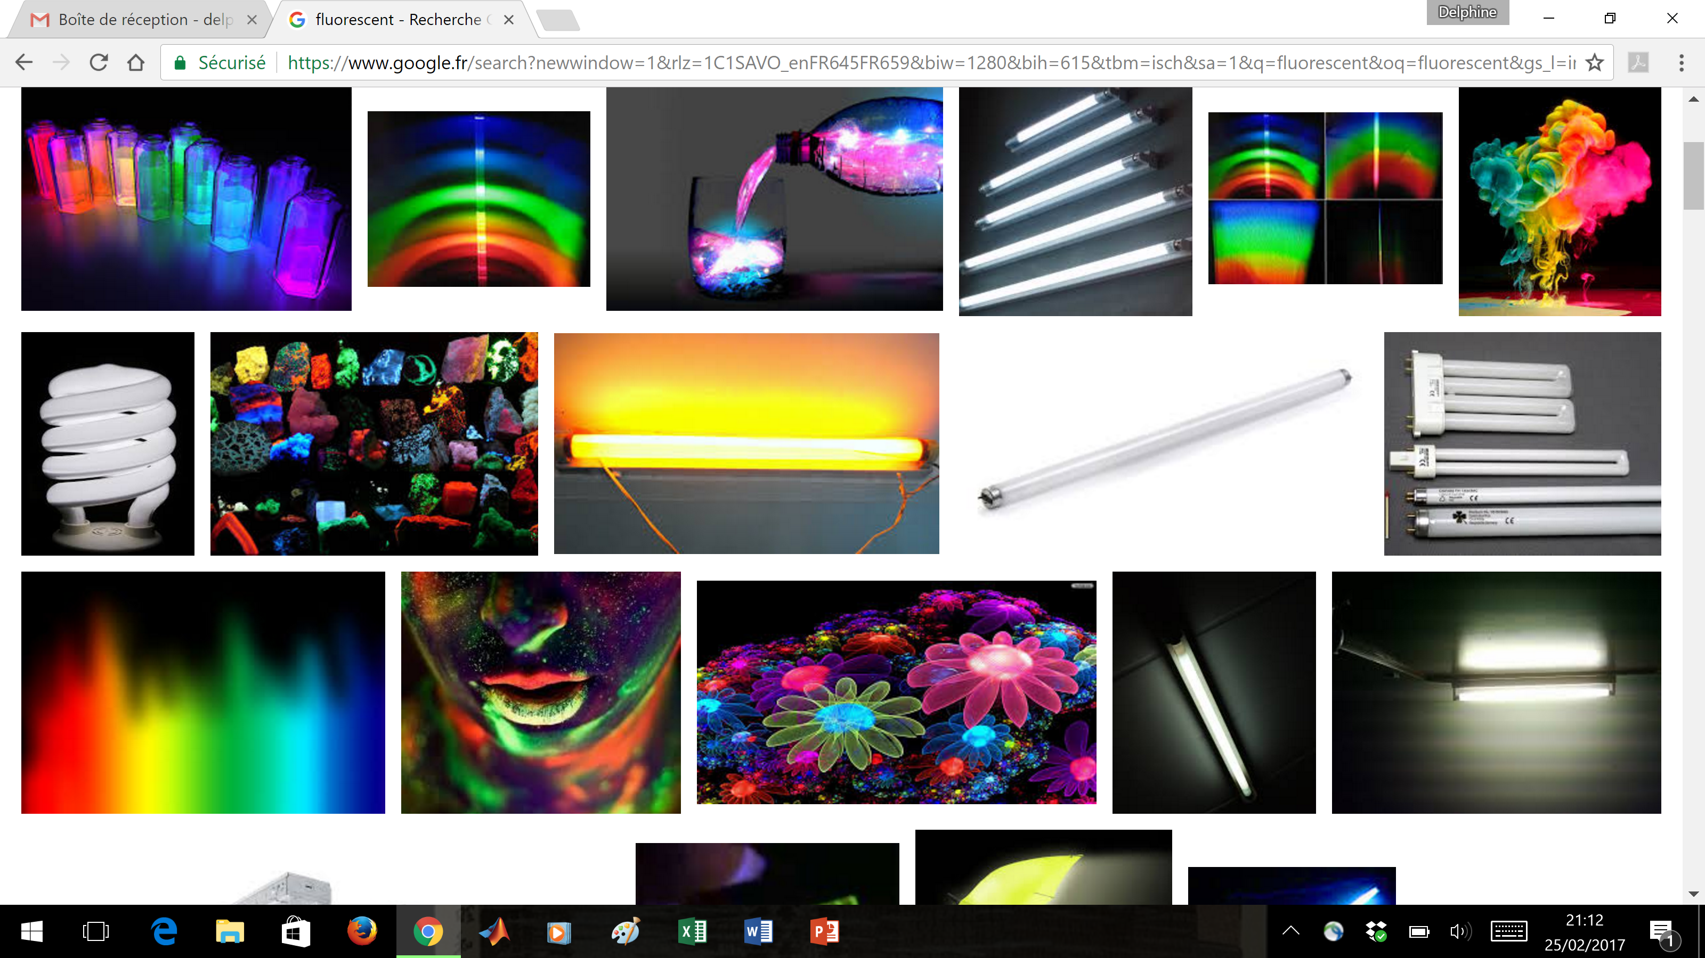
What is fluorescence?
On the web:
Flashy colors
Notes:
If you look for FLUORESCENCE on the web, here is what you may get: cool and flashy colors, with a little bit of art too.

Slide 3
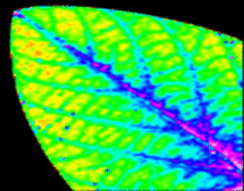
What is fluorescence?
On the web:
Flashy colors
But also, further on the web:
Marker of photosynthesis
adapted from earthobservatory.nasa.gov
Notes:
It turns out that FLUORESCENCE is also a real science subject and apart from turning green vegetation into flashy colors, it is actually a marker of photosynthetic activity. So now, how does it work?

Slide 4
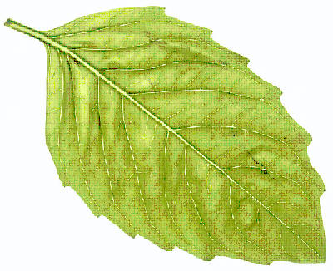
What is fluorescence?
Carbon fixation by the terrestrial biosphere, or Gross Primary Productivity (GPP), constitutes the largest flux in the terrestrial carbon balance
Small fraction of light that is reemitted from the leaf chlorophyll during the photosynthesis process (~1-2%)
Energy dissipated for photo
synthesis
Energy dissipated by fluo
rescence

Slide 5
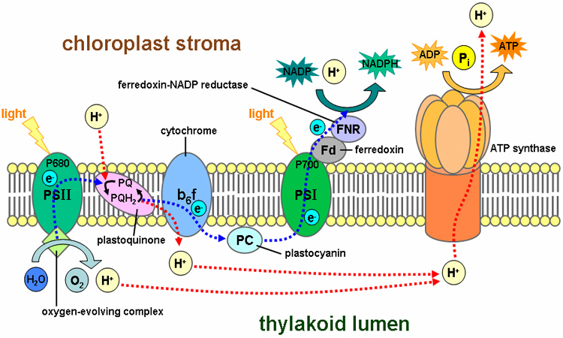
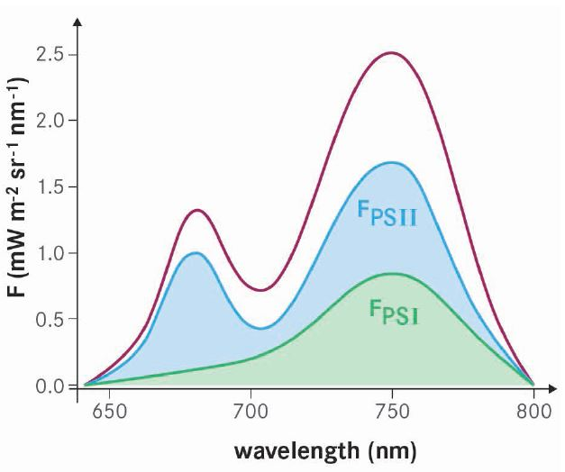
What is fluorescence?
Carbon fixation by the terrestrial biosphere, or Gross Primary Productivity (GPP), constitutes the largest flux in the terrestrial carbon balance
Small fraction of light that is reemitted from the leaf chlorophyll during the photosynthesis process (~1-2%)
Two photosystems emitting mainly at 2 frequencies: 685 nm (red) and 740 nm (far-red)

Slide 6
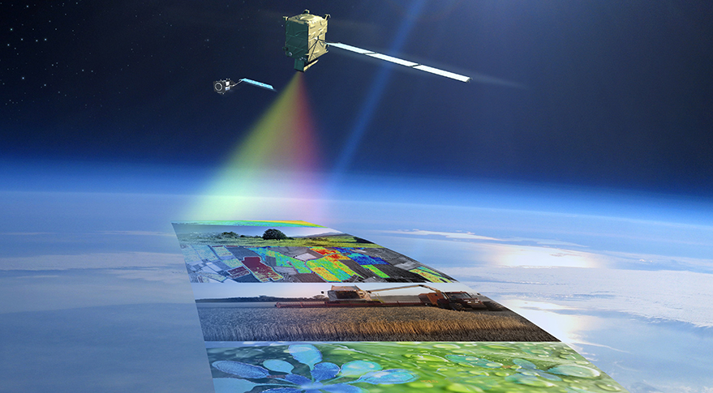
What is fluorescence?
Carbon fixation by the terrestrial biosphere, or Gross Primary Productivity (GPP), constitutes the largest flux in the terrestrial carbon balance
Small fraction of light that is reemitted from the leaf chlorophyll during the photosynthesis process (~1-2%)
Two photosystems emitting mainly at 2 frequencies: 685 nm (red) and 740 nm (far-red)
Still on-going research with the preparation of the future ESA mission FLEX: remote sensing of the fluorescence (launch 2022)

Slide 7
ISBA-A-gs with the NIT option
ISBA
water & energy budget
Interaction Soil Biosphere Atmosphere

Slide 8
ISBA-A-gs with the NIT option
A-gs (Jacobs, 1996; Calvet et al., 1998)
@ leaf & canopy scales
Variable parameters:
g_{m}, D_{max}, f₀
CO₂ net assimilation & GPP
Stomatal conductance
ISBA
water & energy budget

Slide 9
ISBA-A-gs with the NIT option
A-gs (Jacobs, 1996; Calvet et al., 1998)
@ leaf & canopy scales
Variable parameters:
g_{m}, D_{max}, f₀
CO₂ net assimilation & GPP
Stomatal conductance
ISBA
water & energy budget
Soil moisture stress + drought avoiding / tolerant behavior
Calvet, 2000; Calvet et al., 2004

Slide 10
ISBA-A-gs with the NIT option
A-gs (Jacobs, 1996; Calvet et al., 1998)
@ leaf & canopy scales
Variable parameters:
g_{m}, D_{max}, f₀
CO₂ net assimilation & GPP
Stomatal conductance
ISBA
water & energy budget
“NIT” configuration
Soil moisture stress + drought avoiding / tolerant behavior
Calvet, 2000; Calvet et al., 2004
Growth and Mortality
biomass = Σ(growth-senescence)
growth = Σ A_{n}
senescence = exp. law
Nitrogen dilution
SLA = e × N_{L} + f
Interactive LAI
LAI = biomass × SLA
Gibelin et al., 2006
Calvet et al., 1998; Calvet and Soussana 2001

Slide 11
Fluorescence observations
Sun Induced Fluorescence (SIF) product:
from reflectance observed by GOME-2 instrument on board MetOp-A platform using a simplified radiative model (Joiner et al., 2013)
observed reflectance = F(atm. properties, surface reflectivity, fluorescence)
gridded data (v26), far-red spectrum (740 nm), monthly averages to smooth the noise as recommended, points too close to coasts are removed
http://avdc.gsfc.nasa.gov/pub/data/satellite/MetOp/
SIF retrievals
March 2014
July 2014
mW/m²/sr/nm

Slide 12
ISBA-A-gs with the NIT option
CO₂ responsive parameterization of photosynthesis
Photosynthesis drives vegetation growth and senescence
Gross Primary Production (GPP) can be simulated
SURFEX v8, 3-L (force-restore)
ERA-Interim forcing: 3-hour, 0.5°
Sequential assimilation of both SSM and LAI observations using a simplified Extended Kalman Filter (EKF) at the European scale (LDAS-Monde)
Copernicus Global Land Service (http://land.copernicus.vgt.vito.be)
Soil Water Index from ASCAT: daily, 0.1°resolution
LAI from SPOT-VGT and PROBA-V: 10-day, 1 km resolution

Slide 13
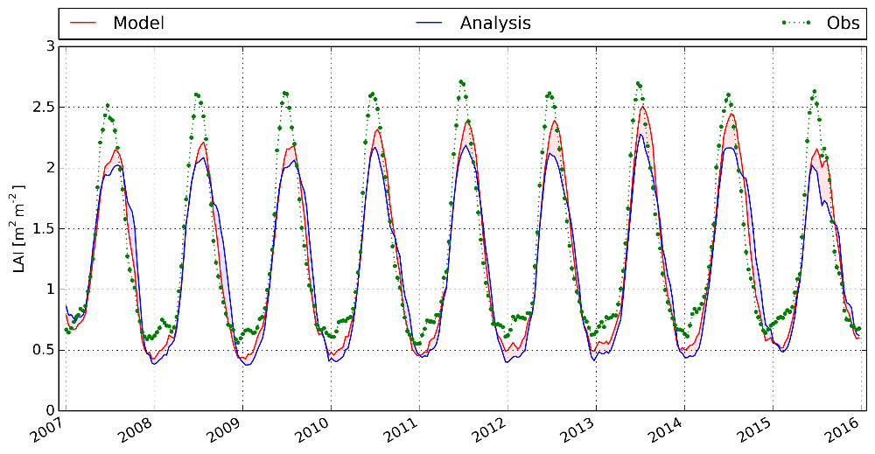
LAI time series and correlation map - Europe
Model
Analysis
Obs.

Slide 14
LAI time series and correlation map - Europe
Model
Analysis
Obs.
R(model)
R(analysis)
R(analysis)-R(model)
(red = improvement)

Slide 15
Comparison between GPP simu. and SIF obs.
Monthly time series, 2007-2015 (not the same units)

Slide 16
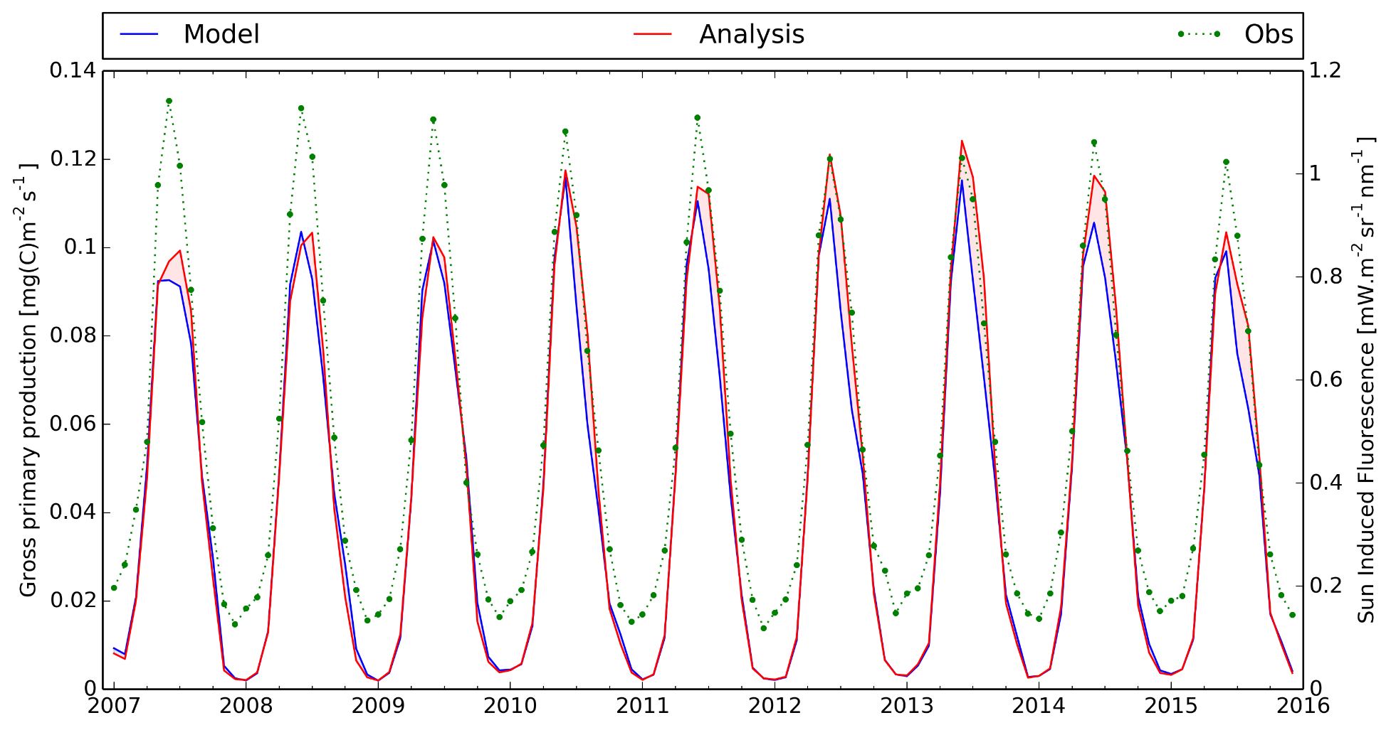
Comparison between GPP simu. and SIF obs.
Monthly time series, 2007-2015 (not the same units)
R=0.99
R=0.98

Slide 17
Comparison between GPP simu. and SIF obs.
Annual correlation scores (slight improvement after assimilation)

Slide 18
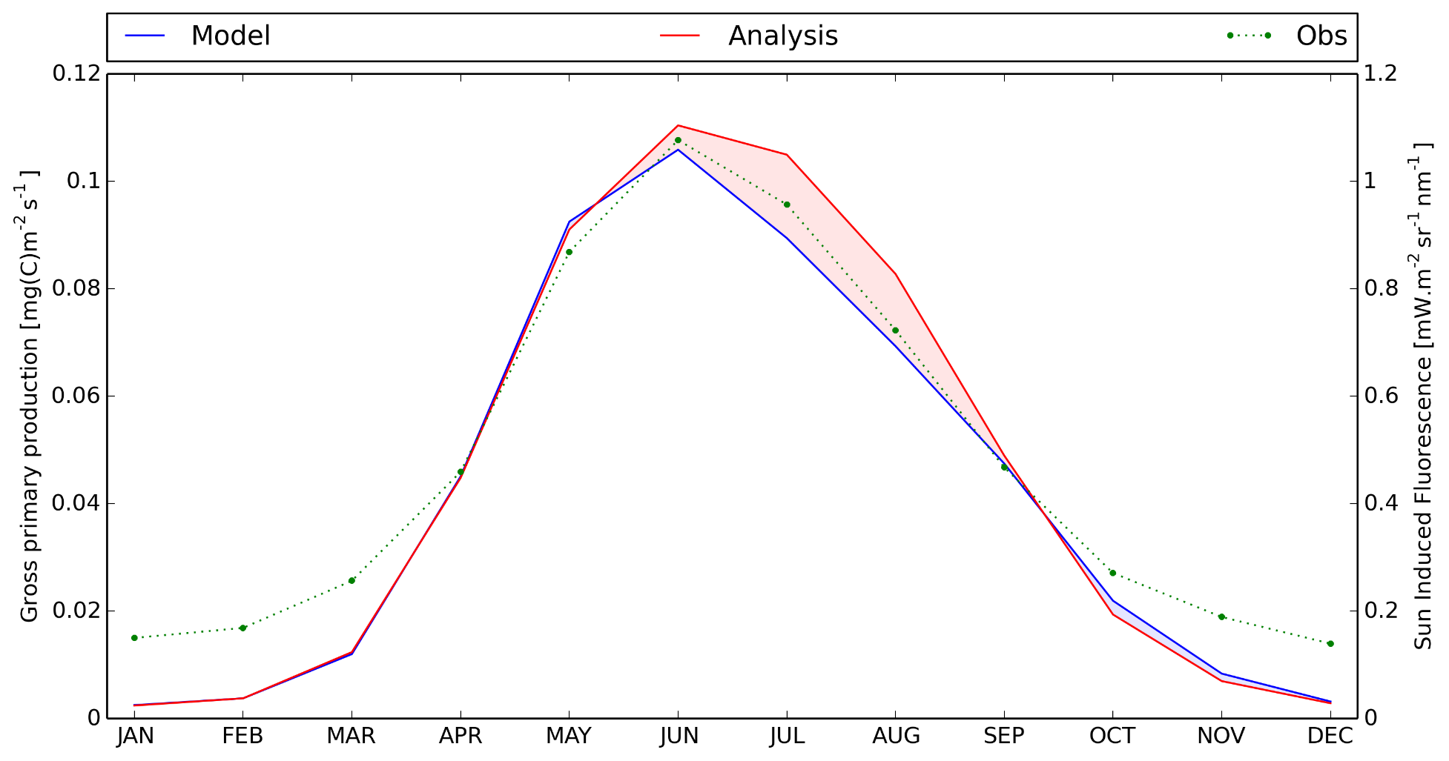
Comparison between GPP simu. and SIF obs.
Monthly climatology series, 2007-2015 (not the same units)

Slide 19
Comparison between GPP simu. and SIF obs.
Correlation maps for the whole period (2007-2015)
(red = improvement)

Slide 20
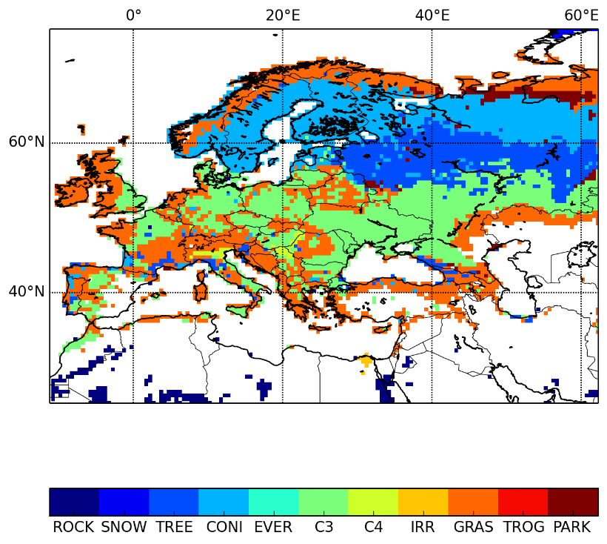
Comparison between GPP simu. and SIF obs.
Correlation maps for the whole period (2007-2015)
(red = improvement)
Correlation is equivalent or better, especially for C3 crops (green)

Slide 21
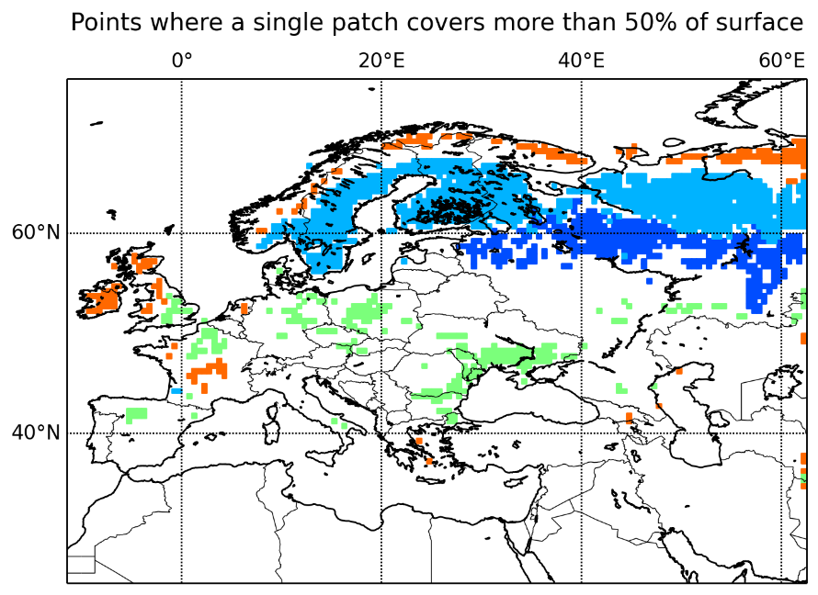
Comparison between GPP simu. and SIF obs.

Slide 22
Comparison between GPP simu. and SIF obs.
Coniferous
R²=0.83
GPP=16.1xSIF-1.5
Deciduous
R²=0.90
GPP=12.9xSIF-0.3

Slide 23
Comparison between GPP simu. and SIF obs.
Coniferous
R²=0.83
GPP=16.1xSIF-1.5
Deciduous
R²=0.90
GPP=12.9xSIF-0.3

Slide 24
Comparison between GPP simu. and SIF obs.
Coniferous
R²=0.83
GPP=16.1xSIF-1.5
Deciduous
R²=0.90
GPP=12.9xSIF-0.3
C3 crops
R²=0.93
GPP=9.8xSIF-1.5

Slide 25
Comparison between GPP simu. and SIF obs.
Coniferous
R²=0.83
GPP=16.1xSIF-1.5
Deciduous
R²=0.90
GPP=12.9xSIF-0.3
Northern EU
Western EU
C3 crops
R²=0.93
GPP=9.8xSIF-1.5
Grassland
R²=0.68
GPP=8.3xSIF-2.3

Slide 26
Comparison between GPP simu. and SIF obs.
In the literature:
GPP modeled vs. SIF retrieved from GOME-2:
 | Slope | Intercept | Vegetation type
Guanter et al. (2012) | 12.5 | 0 | Coniferous forests
 | 7.68 | 0.23 | Deciduous forests
 | 7.69 | -0.31 | Cropland
 | 7.14 | -0.36 | Grassland

Slide 27
Comparison between GPP simu. and SIF obs.
In the literature:
GPP modeled vs. SIF retrieved from GOME-2:
 | Slope | Intercept | Vegetation type
Guanter et al. (2012) | 12.5 | 0 | Coniferous forests
 | 7.68 | 0.23 | Deciduous forests
 | 7.69 | -0.31 | Cropland
 | 7.14 | -0.36 | Grassland
Slope | Intercept
16.1 | -1.5
12.9 | -0.3
9.8 | -1.5
8.3 | -2.3

Slide 28
Comparison between GPP simu. and SIF obs.
In the literature:
GPP modeled vs. SIF retrieved from GOME-2:
 | Slope | Intercept | Vegetation type
Guanter et al. (2012) | 12.5 | 0 | Coniferous forests
 | 7.68 | 0.23 | Deciduous forests
 | 7.69 | -0.31 | Cropland
 | 7.14 | -0.36 | Grassland
Slope | Intercept
16.1 | -1.5
12.9 | -0.3
9.8 | -1.5
8.3 | -2.3
x1.8
x1.9

Slide 29
Comparison between GPP simu. and SIF obs.
In the literature:
GPP modeled vs. SIF retrieved from GOME-2:
GPP measured from flux towers vs. SIF retrieved from GOME-2:
 | Slope | Intercept | Vegetation type
Guanter et al. (2012) | 12.5 | 0 | Coniferous forests
 | 7.68 | 0.23 | Deciduous forests
 | 7.69 | -0.31 | Cropland
 | 7.14 | -0.36 | Grassland
Slope | Intercept
16.1 | -1.5
12.9 | -0.3
9.8 | -1.5
8.3 | -2.3
x1.8
x1.9
 | Slope | Intercept | Vegetation type
Guanter et al. (2014) | 3.55 | -0.88 | Cropland (US)
 | 3.71 | 0.35 | Grassland (EU)
Duveiller et al. (2016) | 5.6 | 0.29 | Coniferous forests (FLUXNET)
 | 5.0 | -0.77 | Deciduous forests (FLUXNET)
 | 4.7 | -0.57 | Grassland (FLUXNET)
might be scale issues between obs. and meas.

Slide 30
Comparison between GPP simu. and SIF obs.
In the literature:
GPP modeled vs. SIF retrieved from GOME-2:
GPP measured from flux towers vs. SIF retrieved from GOME-2:
 | Slope | Intercept | Vegetation type
Guanter et al. (2012) | 12.5 | 0 | Coniferous forests
 | 7.68 | 0.23 | Deciduous forests
 | 7.69 | -0.31 | Cropland
 | 7.14 | -0.36 | Grassland
Slope | Intercept
16.1 | -1.5
12.9 | -0.3
9.8 | -1.5
8.3 | -2.3
x1.8
x1.9
 | Slope | Intercept | Vegetation type
Guanter et al. (2014) | 3.55 | -0.88 | Cropland (US)
 | 3.71 | 0.35 | Grassland (EU)
Duveiller et al. (2016) | 5.6 | 0.29 | Coniferous forests (FLUXNET)
 | 5.0 | -0.77 | Deciduous forests (FLUXNET)
 | 4.7 | -0.57 | Grassland (FLUXNET)
might be scale issues between obs. and meas.
x1.2

Slide 31
Conclusions and perspectives
ISBA-A-gs can simulate photosynthesis at large scales (European and global) with a CO₂ responsive parameterization
GPP simulations and SIF observations are very well correlated => validation
GPP-SIF relationship strongly depends on the vegetation type, climate and illumination status
SIF-GPP relationship is not as straightforward as it seems and there is a need for a more comprehensive model (SCOPE model)

Slide 32
Conclusions and perspectives
ISBA-A-gs can simulate photosynthesis at large scales (European and global) with a CO₂ responsive parameterization
GPP simulations and SIF observations are very well correlated => validation
GPP-SIF relationship strongly depends on the vegetation type, climate and illumination status
SIF-GPP relationship is not as straightforward as it seems and there is a need for a more comprehensive model (SCOPE model)
Improvement of the photosynthesis representation with a vegetation clumping index for leaf optical properties (work in progress)
Improvement of prescribed LAI min values (work in progress, previous presentation from Simon Munier)
Observation operator for the assimilation of surface albedo and fluorescence in ISBA-A-gs to better constraint the photosynthesis (work in progress)

